Slide 1

Capstone Project- The battle of Neighborhood
Akshat jain

Slide 2
Introduction
Background : Safety is top concern when moving to a new area.
Problem : This project aims to select safest place and cluster top 10 venues in each neighbourhood using k-means.

Slide 3
Data Acquisition and cleaning
Data Acquisiiton : the data for this project is a combination of data from three source
# crime data set from Kaggle
# London boroughs from Wikipedia
# List of neighborhoods of Kingston upon Thames from Wikipedia.

Slide 4
Methodology
Data Cleaning: The data cleaning process for each of the three sources of data are done separately.
From the London crime data, the crimes during the most recent year (2016) are only selected. The major categories of crime are pivoted to get the total crimes per the boroughs for each major category.
The second data is scraped from a wikipedia page using the Beautiful Soup library in python. Using this library we can extract the data in the tabular format as shown in the website.
The two data sets are merged on the Borough names to form a new data set. The purpose of this data set is to visualize the crime rates in each borough and identify the borough with the least crimes recorded during the year 2016.
After visualizing the crime in each borough we can find the borough with the lowest crime rate. The third data set is created, with the names of the neighborhoods and the name of the borough with the latitude and longitude obtained using Google Maps API geocoding.
The new data set is used to generate the 10 most common venues for each neighborhood using the Foursquare API, finally using k means clustering algorithm to cluster similar neighborhoods together

Slide 5
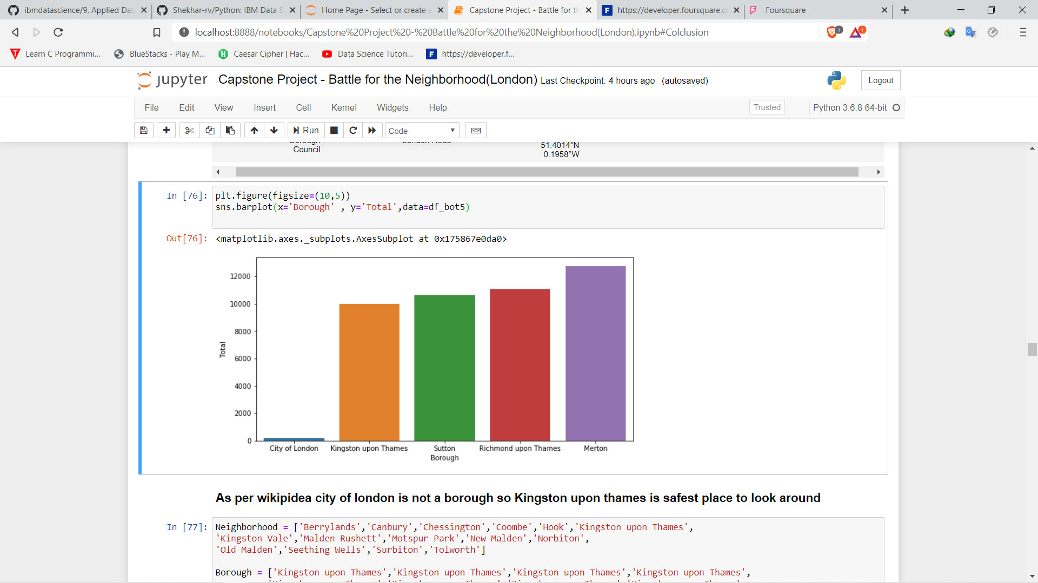
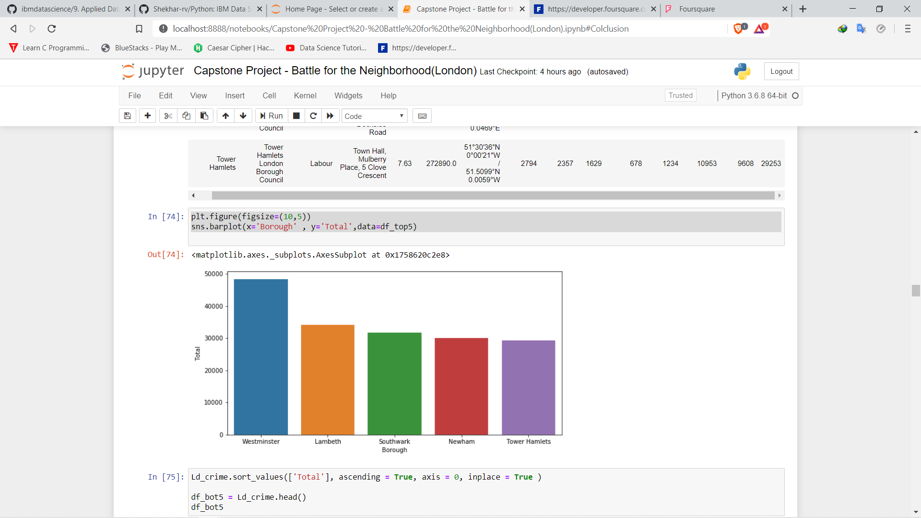
Data analysis
Plot with lowest crimes
Plot with heighest crimes

Slide 6
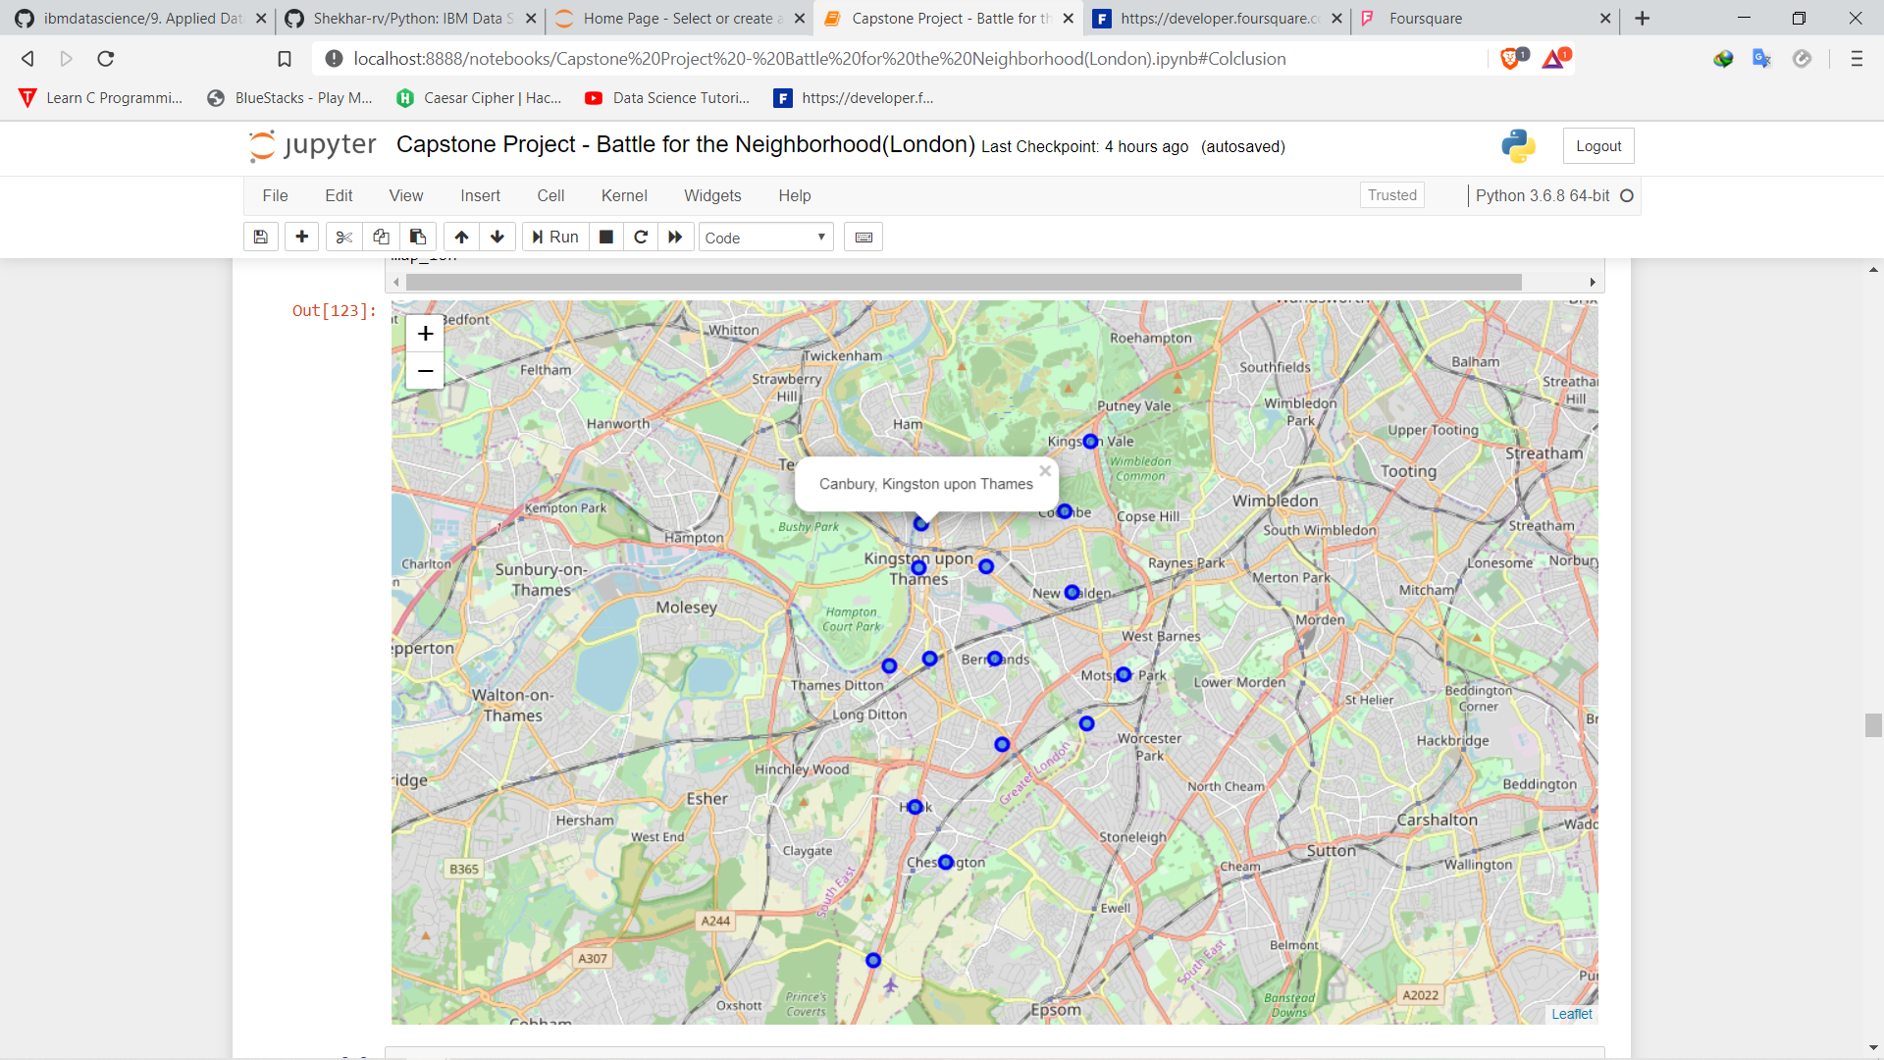
Neighbourhood
Of Kingston upon
Thames.

Slide 7
Modeling
Using the final data set containing the neighborhoods in Kingston upon Thames along with the latitude and longitude, we can find all the venues within a 500 meter radius of each neighborhood by connecting to the Foursquare API.
One hot encoding is done on the venues data. The Venues data is then grouped by the Neighborhood and the mean of the venues are calculated, finally the 10 common venues are calculated for each of the neighborhoods.
To help people find similar neighborhoods in the safest borough we will be clustering similar neighborhoods using K - means clustering which is a form of unsupervised machine learning algorithm that clusters data based on predefined cluster size.
We will use a cluster size of 5 for this project that will cluster the 15 neighborhoods into 5 clusters. The reason to conduct a K- means clustering is to cluster neighborhoods with similar venues together so that people can shortlist the area of their interests based on the venues/amenities around each neighborhood.

Slide 8
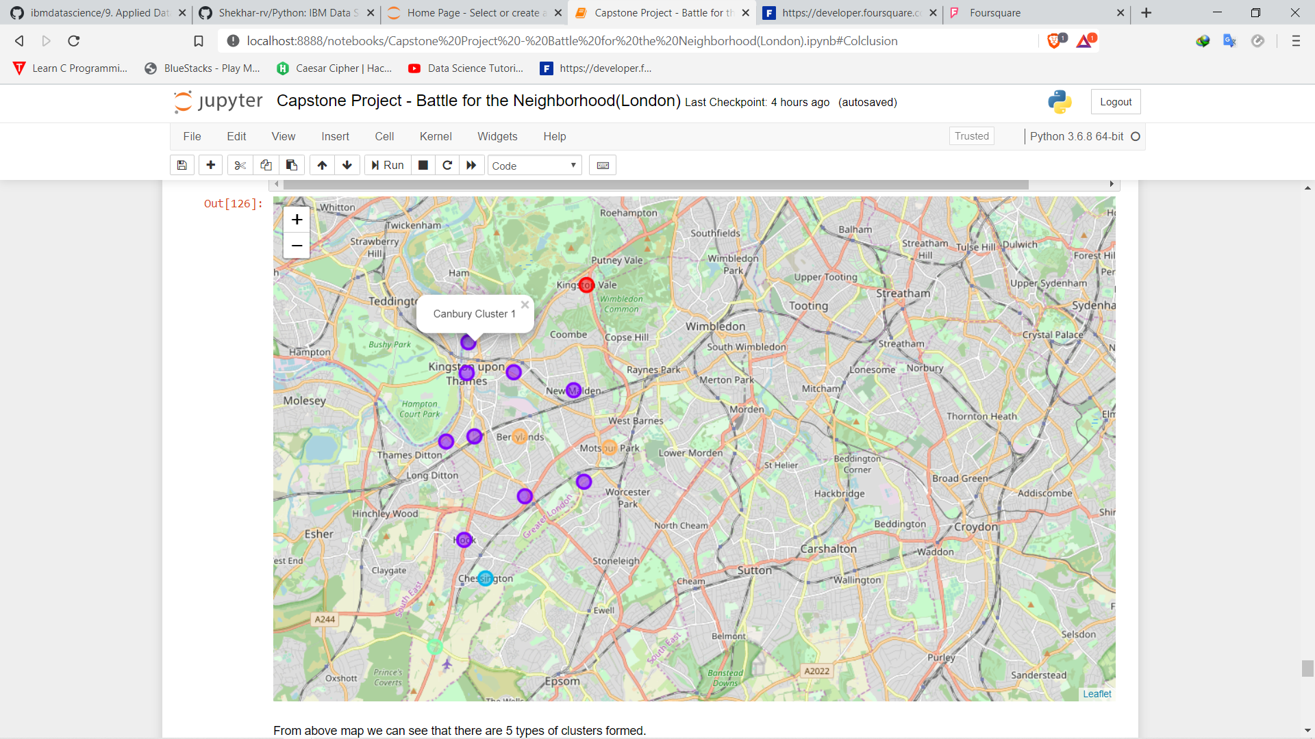
Results

Slide 9
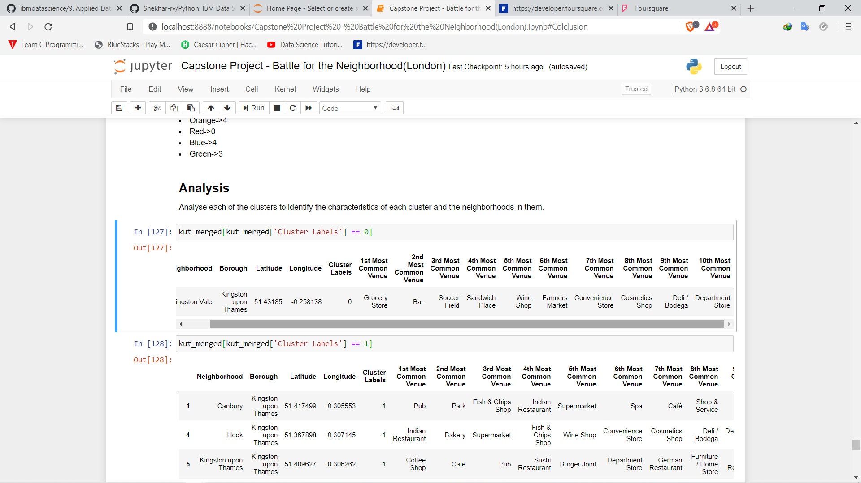
Cluster 0

Slide 10
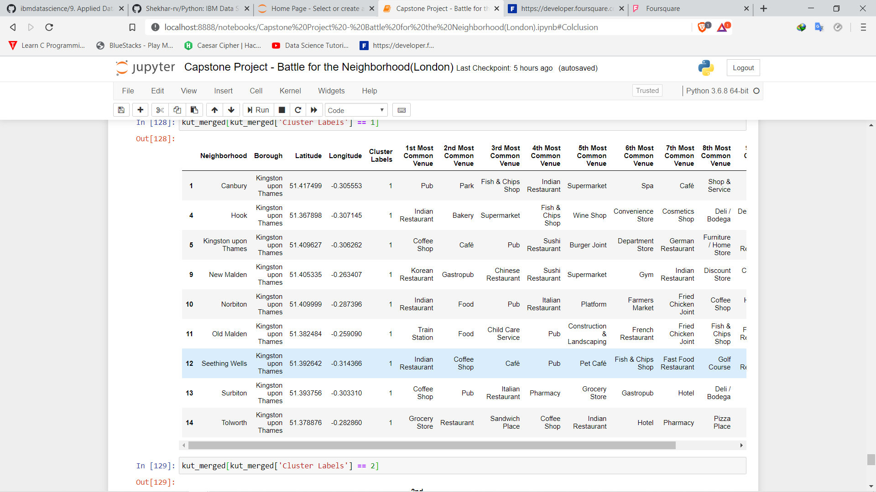
Cluster 1

Slide 11
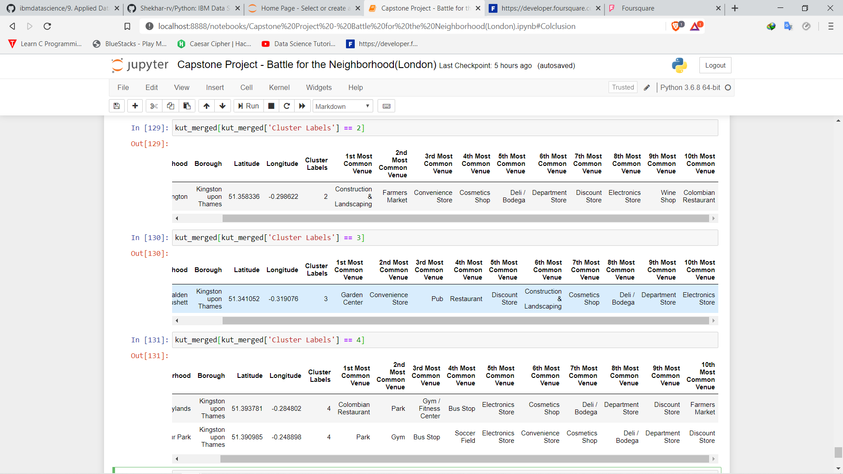
Cluster 2 , 3 and 4

Slide 12
results
The aim of this project is to help people find the safe place in london where they can facilities as per their requirement.
We can see that most of the Venues are covered in Cluster 1 so it would be the perfect place to look at but it will be crowdy.
So, as per the requirements and budget people can choose

Slide 13
conclusion
This project helps a person get a better understanding of the neighborhoods with respect to the most common venues in that neighborhood.
Using Data Analysis and machine learning to help people in making their decision. We have not included cost of living so future of this project will be to include it and then short list based of safety and budget.

